Slide 1
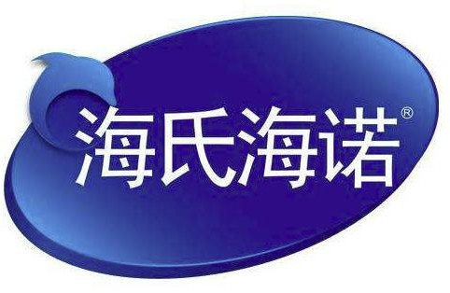
QINGDAO HAINUO GROUP
About us
OUR BRANDS
Hainuo Group was founded in 2004 and now has more than 20 subsidiary corporations. Our headquarter is located in Jiangshan industrial park in Laixi, Qingdao, which is very close to the main highway, Huashan International Golf Course, Qingdao International Airport and Qingdao Harbor. Our factory covers an area of 220,000 square meters with super geographical position and convenient transportation.
HYNAUT for Overseas Market
We have a dozen up-to-date factories, multiple Class 100,000 cleanrooms and Class 300,000 cleanrooms, modern logistics and storage facilities, advanced production facilities and detecting instruments. More than 2,000 professional staffs devote themselves to their job and the development of Hainuo, a lot of them are experts, professors and licensed pharmacists from Chinese Pharmaceutical Association as well as the State Council. We also have technology support and cooperation of many research institutions and companies from USA, Germany and Taiwan, China.
Hainuo keeps moving forward and we're always open to your ideas and advices. Please don't hesitate to let us know if you're interested in working with us and a deeper level of cooperation!
HAINUO for Domestic Market

Slide 2
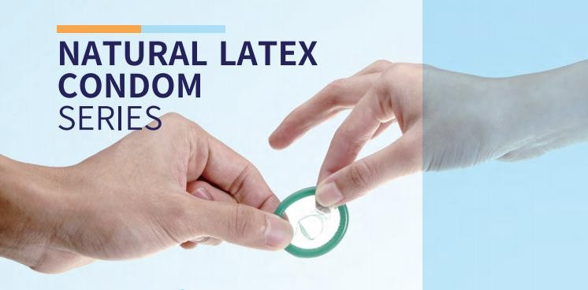
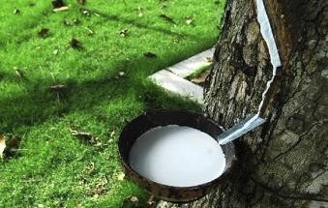
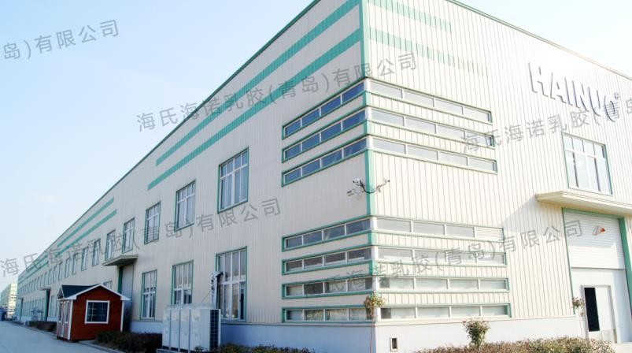
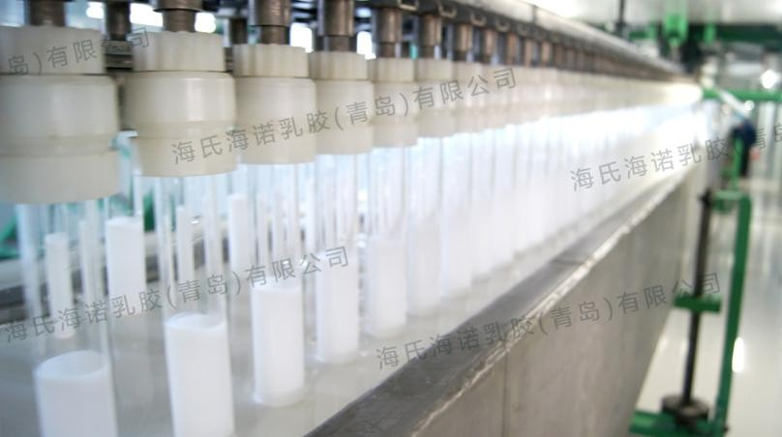
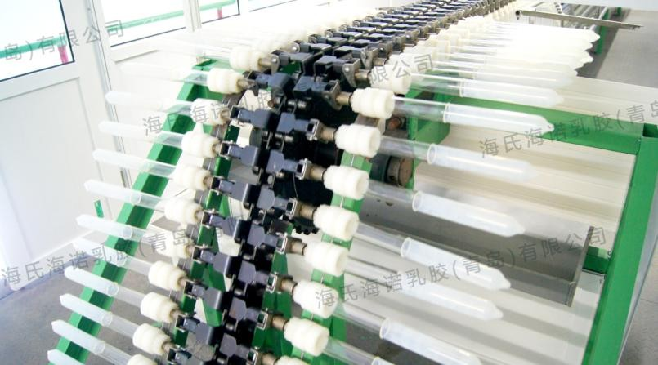
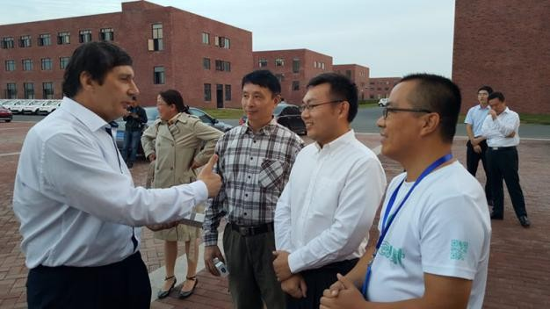
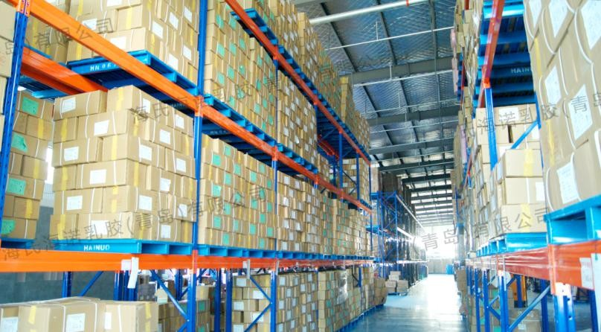
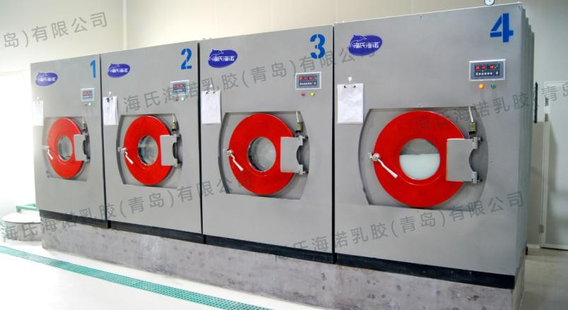
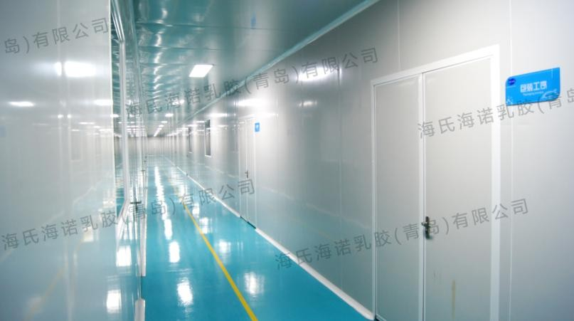
NATURAL LATEX CONDOMS
Why choosing us?
< 1 > Raw Material
< 2 > Dipping & Vulcanization
The best quality latex from Thailand
Superior food-grade silicone oil (BRB) and low-residue water-based lubricant from the Netherlands.
≥ 10 times testing before entering factory
Special formula, refined lapping, accurate temperature control
Multiple times of gum dipping and drying
Guarantee of uniform thickness and great transparency
Class 300,000 dust-free cleanrooms

Slide 3
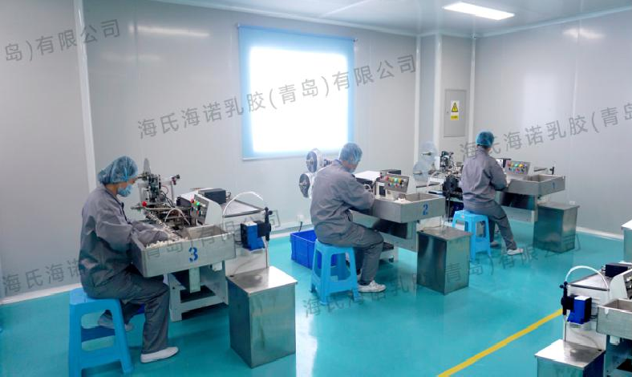
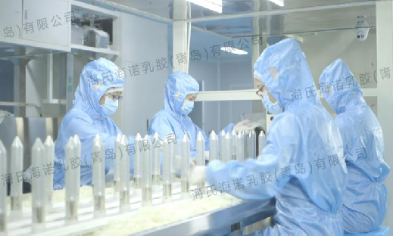
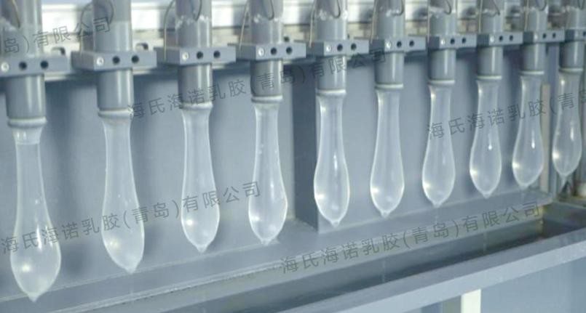
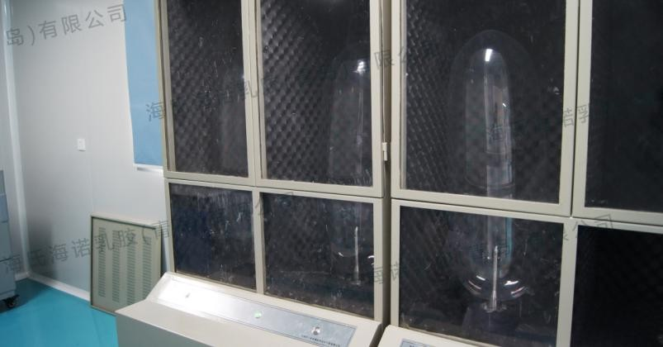
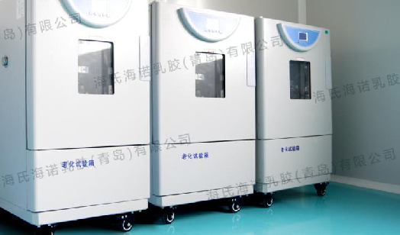
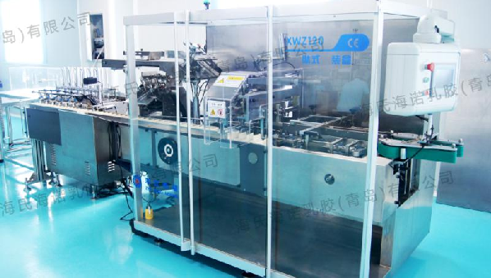
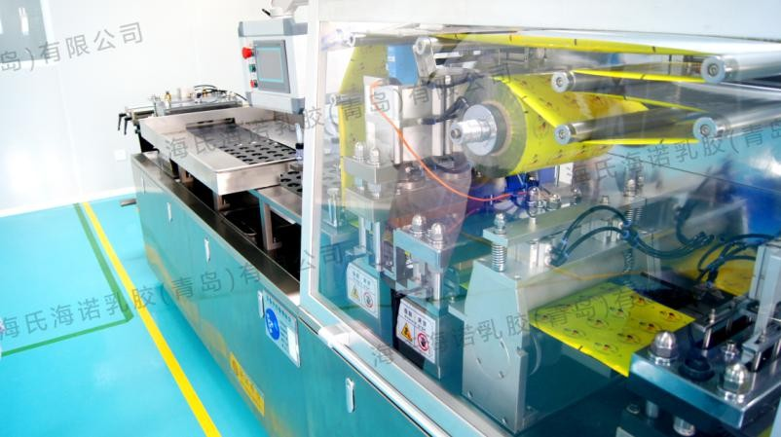
NATURAL LATEX CONDOMS
Why choosing us?
< 3 > Strict Quality Control
100% Electronic detection
Pinholes detection
Air charging detection
Ageing resistance detection
< 4 > Packaging Process
Highly automated equipment
Automatic identification and excluding of defective products

Slide 4
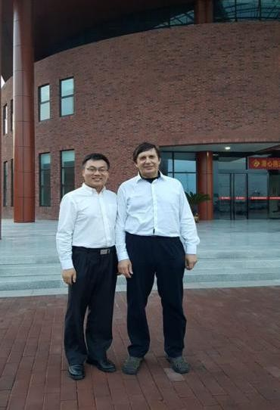
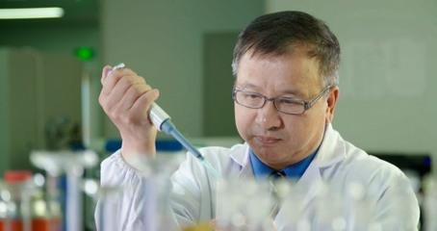
NATURAL LATEX CONDOMS
World-Leading R&D Team
Mr. Fanlei Kong
Production Director at Hainuo Group
Former Production Director at Durex China
20 Years of Experiences in Condom Industry
Mr. Andre Geim
“The Father of Graphene”
Nobel Prize Winner in Physics
Dr. Mizhou Hui
Researcher of Chinese Academy of Sciences
Chief Scientist at Hainuo Group
Multiple Invention Patents

Slide 5
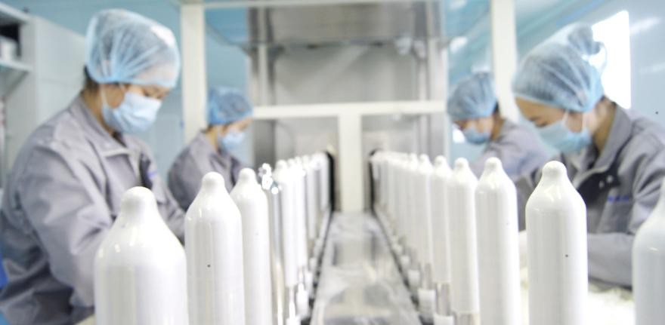

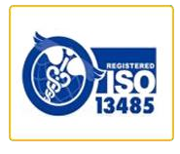


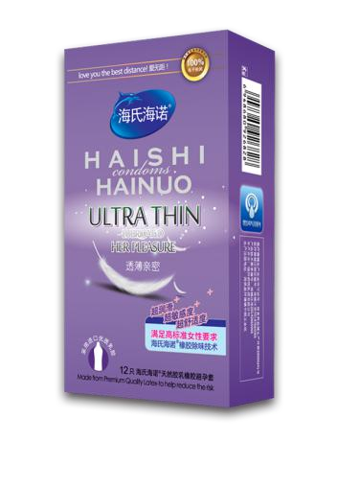
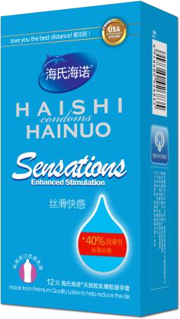
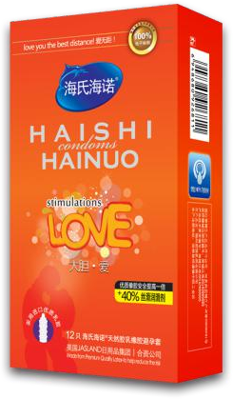
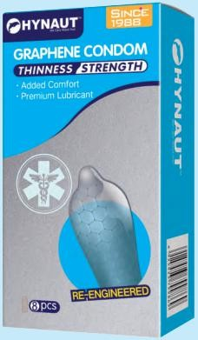
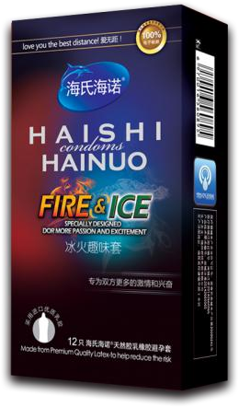
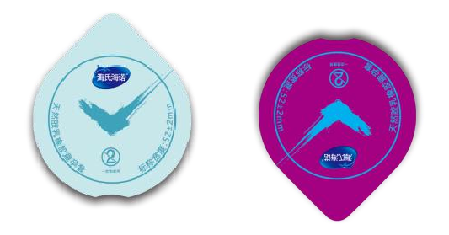
NATURAL LATEX CONDOMS
Customized Production Service
Raw Material: Natural Latex / Graphene
Nominal Width: 52±2mm Length: ≥160mm
Thickness: 0.03mm / 0.04mm / 0.05~0.06mm Style: Glossy / Ribbed / Dotted / Ribbed + Dotted
Capacity of Lubricant: 300 / 500 / 700 / 1000 mg (customizable) Type of Lubricant: Silicone Oil / Water-Based
Odour: Fruity / Potpourri / Odorlessness Color: Original / Pink / Green
Special Additive: B-HA / Repair Gel Packaging: Aluminum Foil Bag / Butter Box Shape of Aluminum Foil Bag:
Oblong / Square (55x55mm, 60x60mm)

Slide 6
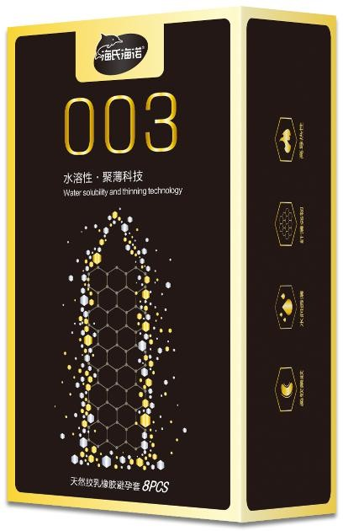
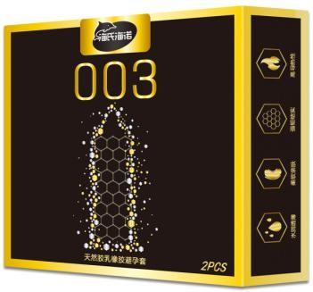
NATURAL LATEX CONDOMS
Our Products Graphene Reinforced Condom
Features:
Graphene, also called "Black Gold", is a very stable hexagonal honeycomb-like flat film.
It has superhigh strength and tenacity, superior electrical and thermal conductivity, super hydrophobicity and lipophilicity. All these features make graphene a revolutionary material for the future.
Ultra thin and sensitive, natural feeling
High thermal conductive, feel the heat
100% HIV-prevention, healthy and safe
High strength and tenacity
Specifications
Specifications
Size: (W) 52±2mm , (L) ≥160mm
Size: (W) 52±2mm , (L) ≥160mm
Thickness: 0.03mm
Thickness: 0.03mm
Style: Glossy
Style: Glossy
Lubricant: Water-based
Lubricant: Water-based
Packaging: 8 pcs/box, 144 boxes/carton
Packaging: 2 pcs/box, 720 boxes/carton

Slide 7

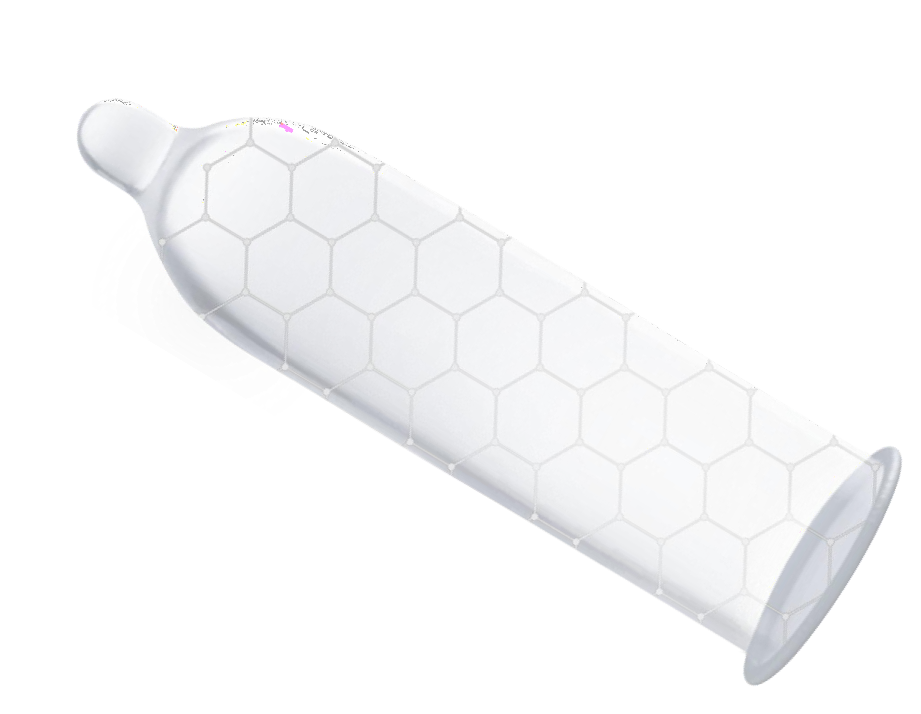







NATURAL LATEX CONDOMS
Why Choosing Graphene Reinforced Condoms?
Ultra Thin & Tenacious
Hexagonal carbon molecular structure disperse pressures, and it gives the condoms ultra thickness and tenacity.
High Thermal Conductive
Graphene is the carbon material with the highest thermal conductivity by so far, which can instantly transfer the heat of skin.
High Protection
The single carbon atom structure of graphene has a very small gap, which is much lower than the structure of HIV, so it can effectively block the transmission of HIV and sexually transmitted diseases.

Slide 8
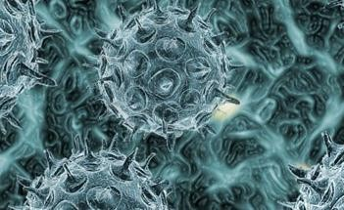
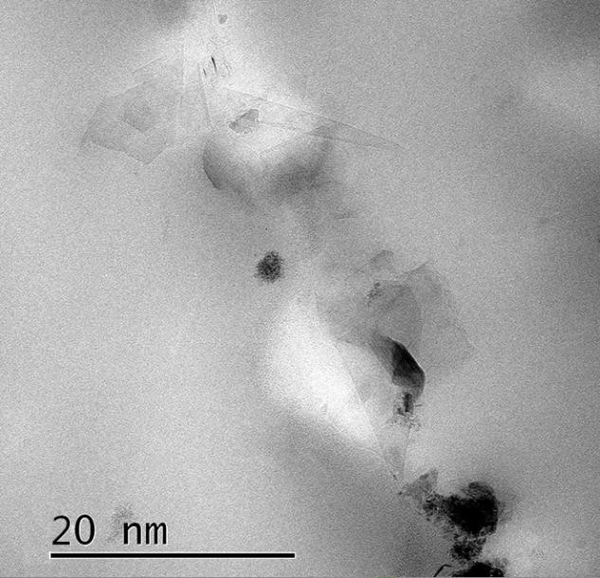
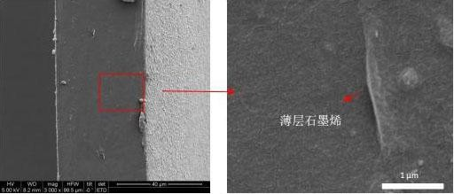

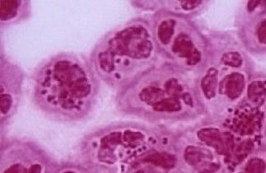
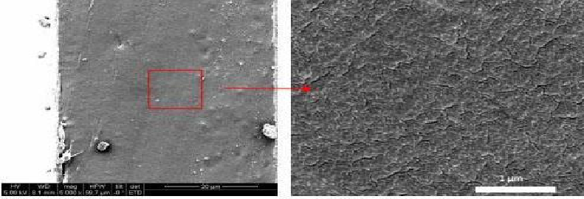
NATURAL LATEX CONDOMS
Why Choosing Graphene Reinforced Condoms?
Inner Wall Comparison:
The virus diameter of HIV, gonorrhoea, etc.: 120~500nm.
Inner Wall of Graphene Condom
The largest gap of sperm is about 5000nm wide, while the gap of latex molecules is about 500nm. Latex condoms can effectively prevent pregnancy, but there're risks of virus infection.
Graphene can fill up the gaps between latex molecules, and the extremely small gap of 20nm can significantly enhance the resistance against virus infection.
Inner Wall of Latex Condom

Slide 9
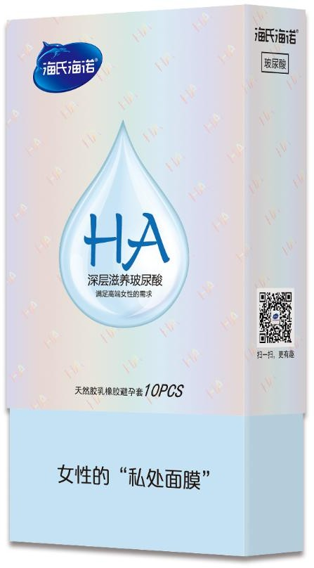
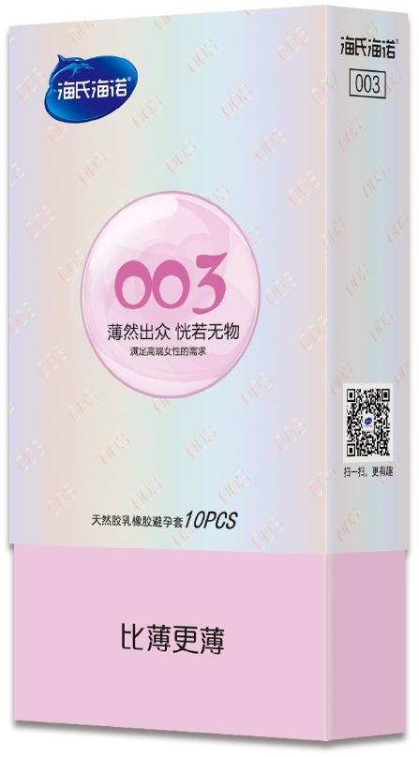
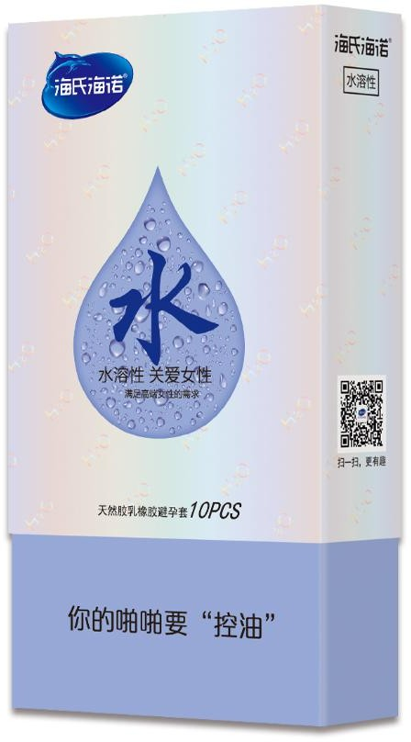
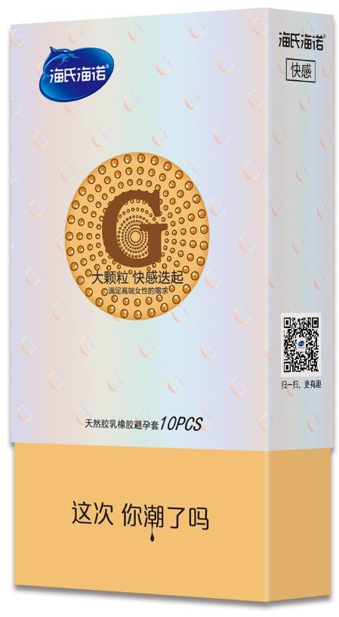
NATURAL LATEX CONDOMS
Our Products “Female Sex” Serie
Features:
Female friendly
B-HA additive nurses the vagina
Excellent antibacterial effect
Ultrathin, natural feeling
STI-prevention, healthy and safe
Premium lubricant
Specifications
B-HA Additive (Water-Based Lubricant)
Size: (W) 52±2mm , (L) ≥160mm
Thickness: 0.03mm / 0.04mm
003 Ultrathin
Style: Glossy / Dotted
Water
(Water-Based Lubricant)
Lubricant: Silicone Oil / Water-Based
Packaging: 10 pcs/box, 360 boxes/carton
Dotted

Slide 10

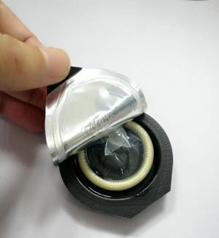
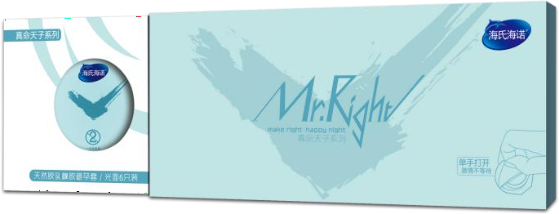
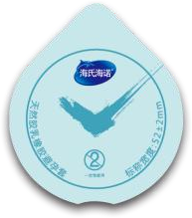
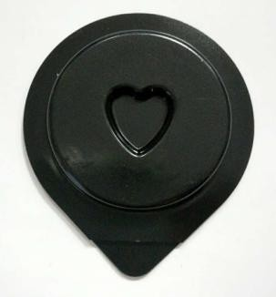
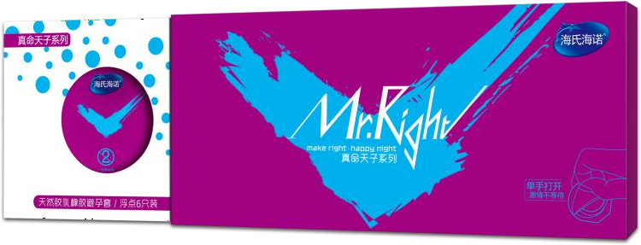
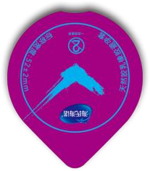
NATURAL LATEX CONDOMS
Our Products
“Mr. Right” Serie
Butter Box Special Design
Specifications
Size: (W) 52±2mm , (L) ≥160mm
Thickness: 0.03mm / 0.04mm
Style: Glossy / Dotted
Lubricant: Silicone Oil
Packaging: 6 pcs/box
Ultrathin
Features:
Heart-shaped sunken design, reduce abrasion due to air pressure.
Food-grade butter box.
Manual placement: Condom will face up all the time, easy to find the right side.
Big Points

Slide 11
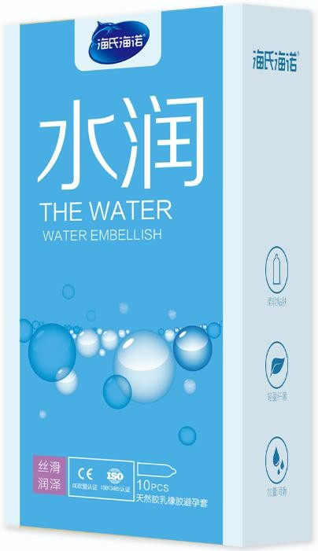
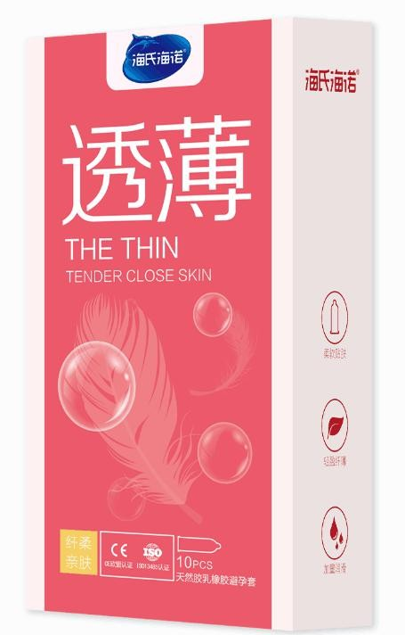
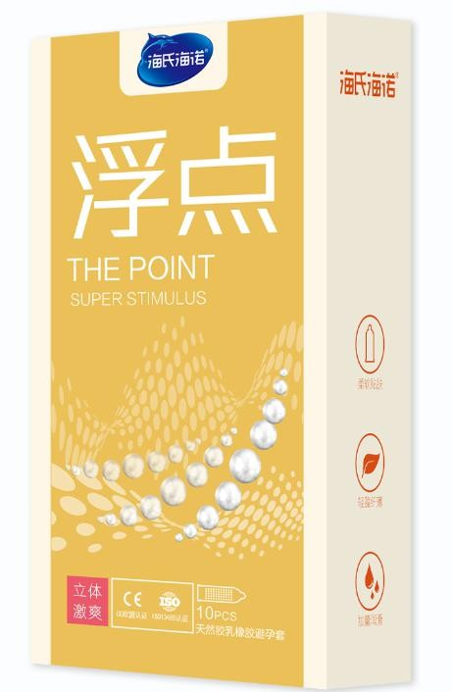
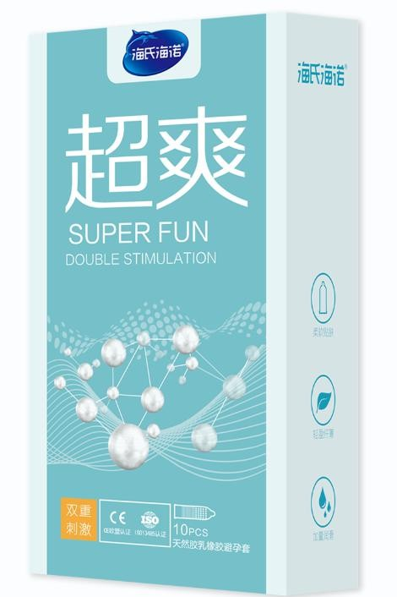
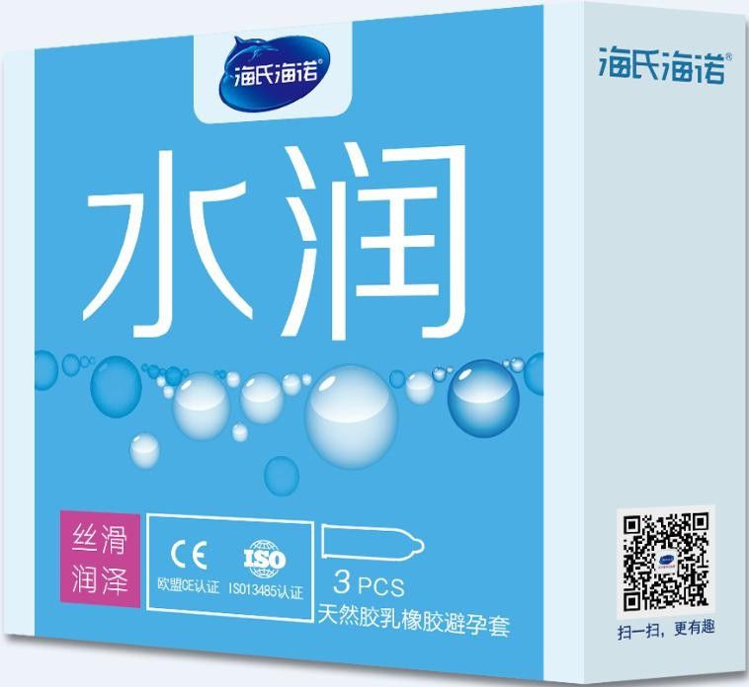

NATURAL LATEX CONDOMS
Our Products “Classic” Serie
Economical & Practical
The Water
Specifications
The Thin
Specifications
The Point
Specifications
Super Fun
Specifications
Size: (W) 52±2mm , (L) ≥160mm
Size: (W) 52±2mm , (L) ≥160mm
Size: (W) 52±2mm , (L) ≥160mm
Size: (W) 52±2mm , (L) ≥160mm
Thickness: 0.05~0.06mm
Thickness: 0.05~0.06mm
Thickness: 0.05~0.06mm
Thickness: 0.05~0.06mm
Style: Glossy
Style: Glossy
Style: Dotted
Style: Ribbed + Dotted
Lubricant: Silicone Oil
Lubricant: Silicone Oil
Lubricant: Silicone Oil
Lubricant: Silicone Oil
Packaging:
10 pcs/box, 360 boxes/carton
3 pcs/box, 720 boxes/carton
Packaging:
10 pcs/box, 360 boxes/carton
•
Packaging:
Packaging:
10 pcs/box, 360 boxes/carton
3 pcs/box, 720 boxes/carton
10 pcs/box, 360 boxes/carton

Slide 12





NATURAL LATEX CONDOMS
Our Products
“Supreme” Serie
+ 40% Lubricant than Classic Serie
Lubricated
Specifications
Sensitive
Specifications
Stimulations Love
Specifications
Fire & Ice
Specifications
Size: (W) 52±2mm , (L) ≥160mm
Size: (W) 52±2mm , (L) ≥160mm
Size: (W) 52±2mm , (L) ≥160mm
Size: (W) 52±2mm , (L) ≥160mm
Thickness: 0.04mm
Thickness: 0.04mm
Thickness: 0.04mm
Thickness: 0.04mm
Style: Glossy
Style: Glossy
Style: Dotted
Style: Glossy
Lubricant: Silicone Oil
Lubricant: Silicone Oil
Lubricant: Silicone Oil
Lubricant: Silicone Oil
Packaging: 12 pcs/box, 360 boxes/carton
Packaging: 12 pcs/box, 360 boxes/carton
Packaging: 12 pcs/box, 360 boxes/carton
Packaging: 12 pcs/box, 360 boxes/carton

Slide 13






NATURAL LATEX CONDOMS
Our Products
“Love” Serie
Features:
Square crush resistance design
Cross-shaped base
Natural feeling, ultimate joy
STI-prevention, healthy and safe
Premium lubricant
LOVE-R (Glossy)
LOVE-H (Ribbed)
Specifications
Size: (W) 52±2mm , (L) ≥160mm
Thickness: 0.05~0.06mm
Style: Glossy / Ribbed / Dotted / Ribbed + Dotted
Lubricant: Silicone Oil
LOVE-S (Dotted)
LOVE-G (Ribbed + Dotted)
Packaging: 10 pcs/box, 288 boxes/carton

Slide 14




NATURAL LATEX CONDOMS
Our Products “Lasting” Serie
Thin
Lubricated
Specifications
Dotted
Specifications
Joy
Specifications
Specifications
Size: (W) 52±2mm , (L) ≥160mm
Size: (W) 52±2mm , (L) ≥160mm
Size: (W) 52±2mm , (L) ≥160mm
Size: (W) 52±2mm , (L) ≥160mm
Thickness: 0.04mm
Thickness: 0.05~0.06mm
Thickness: 0.05~0.06mm
Thickness: 0.05~0.06mm
Style: Glossy
Style: Glossy
Style: Dotted
Style: Ribbed + Dotted
Lubricant: Silicone Oil
Lubricant: Silicone Oil
Lubricant: Silicone Oil
Lubricant: Silicone Oil
Packaging:
10 pcs/box, 360 boxes/carton
Packaging:
10 pcs/box, 360 boxes/carton
•
Packaging:
Packaging:
10 pcs/box, 360 boxes/carton
10 pcs/box, 360 boxes/carton

Slide 15


Contact us!
QINGDAO HAINUO GROUP
Address:
Hainuo Building, No.1 Guangdong Road, Jiangshan International Industrial Park, Laixi District, Qingdao City, Shandong Province, China
Tel.:
+86-532-86999302
Fax:
+86-532-86460000
Website: www.hynautgroup.cn
E-mail: info@hynaut.cn

